Slide 1

Computer Telephony Integration (CTI) with salesforce

Slide 2
Agenda
What is CTI?
Benefits of CTI
Features and its Types
Integrate CTI with salesforce
How to setup CTI and its Output

Slide 3
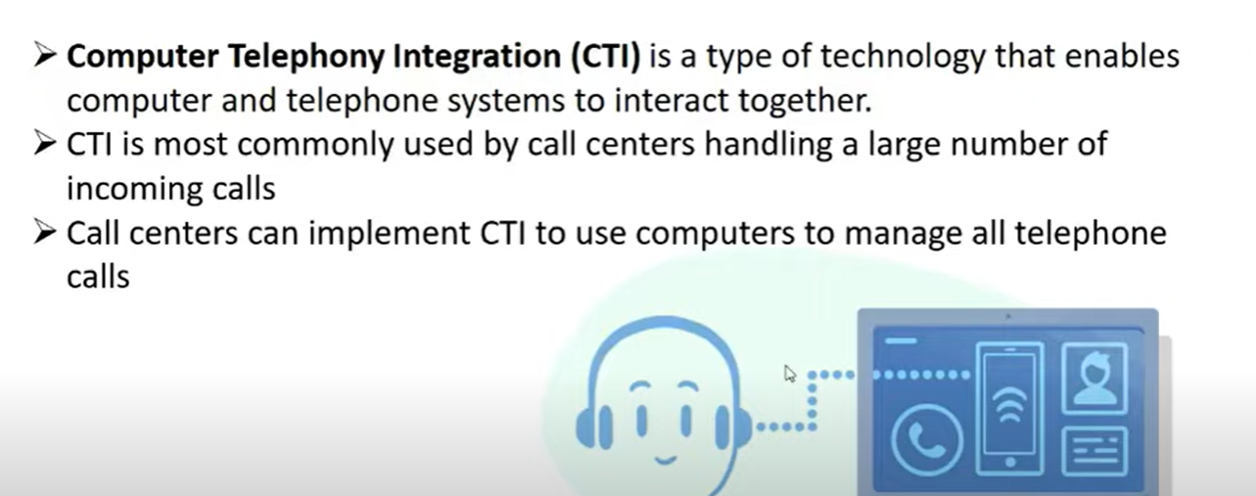
What is CTI?

Slide 4
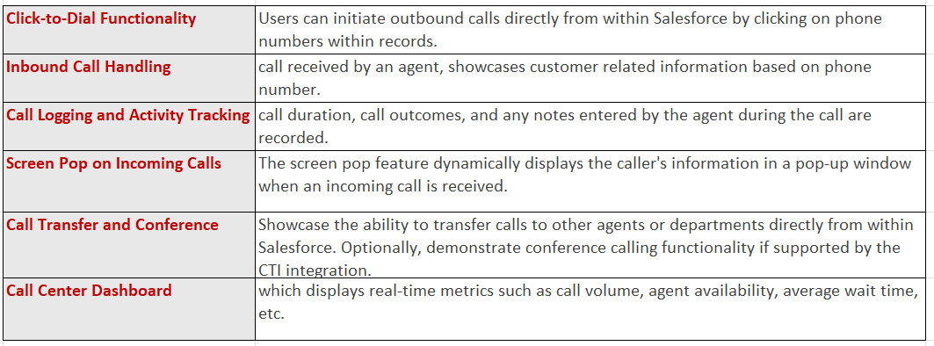
Features Supported by CTI:

Slide 5
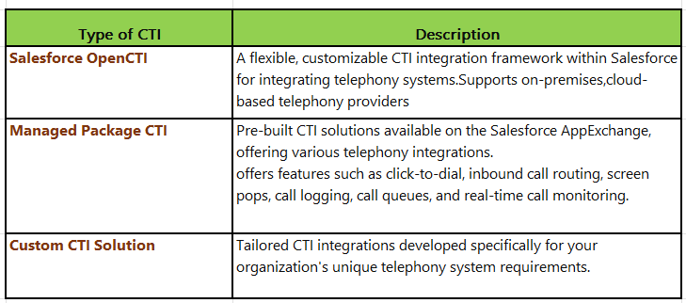

Slide 6
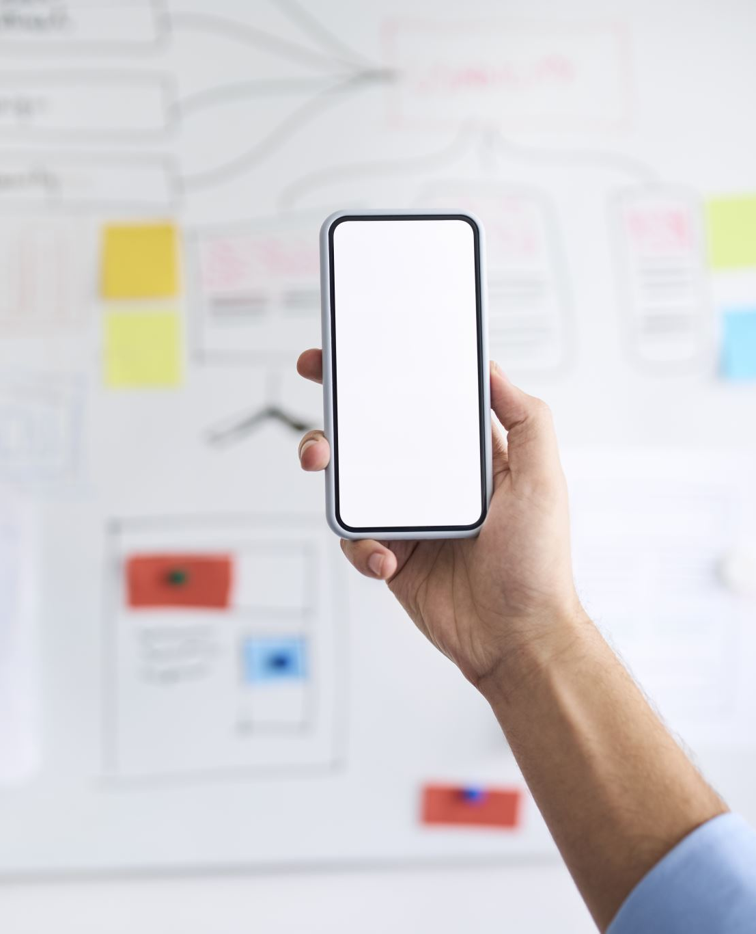
Benefits of CTI Integrations in Salesforce
Enhanced Communication and Collaboration
Improved Customer Service and Support
Streamlined Business Processes and Workflows
Increased Productivity and Efficiency
Real-time Insights and Analytics

Slide 7
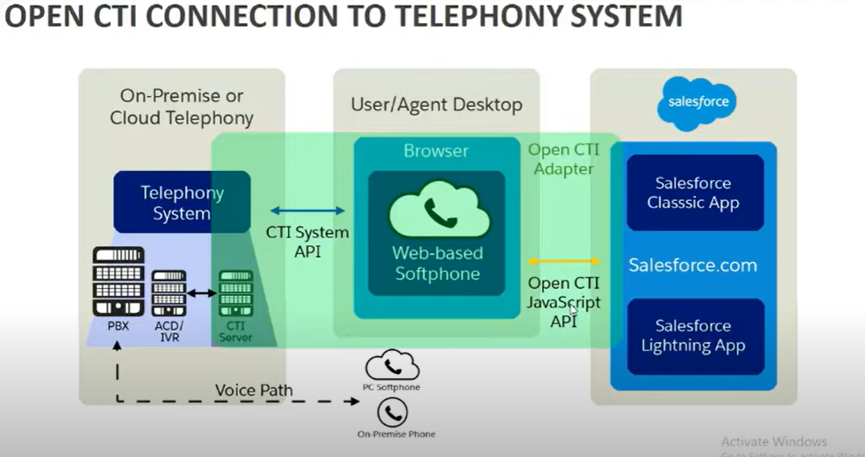
Speaking impact
Your ability to communicate effectively will leave a lasting impact on your audience
Effectively communicating involves not only delivering a message but also resonating with the experiences, values, and emotions of those listening

Slide 8
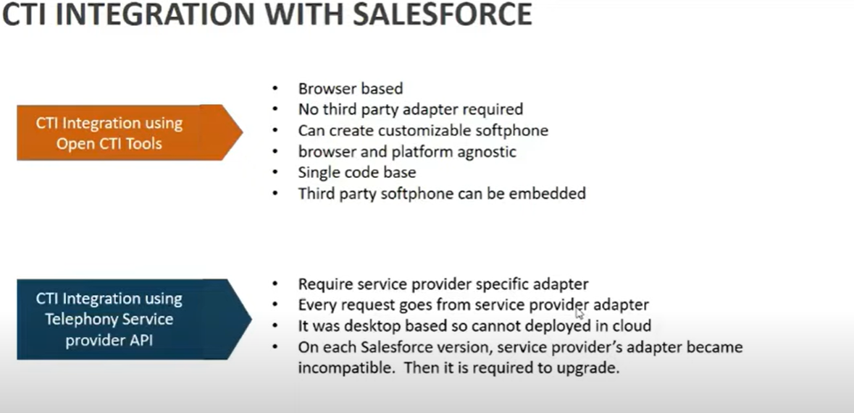

Slide 9
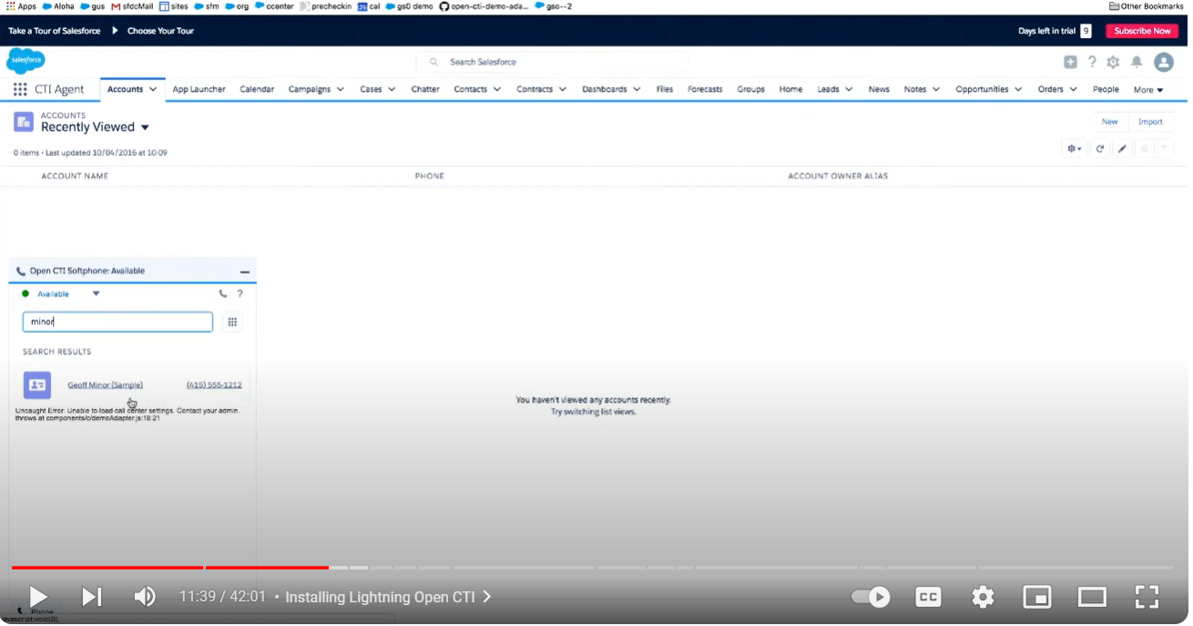

Slide 10
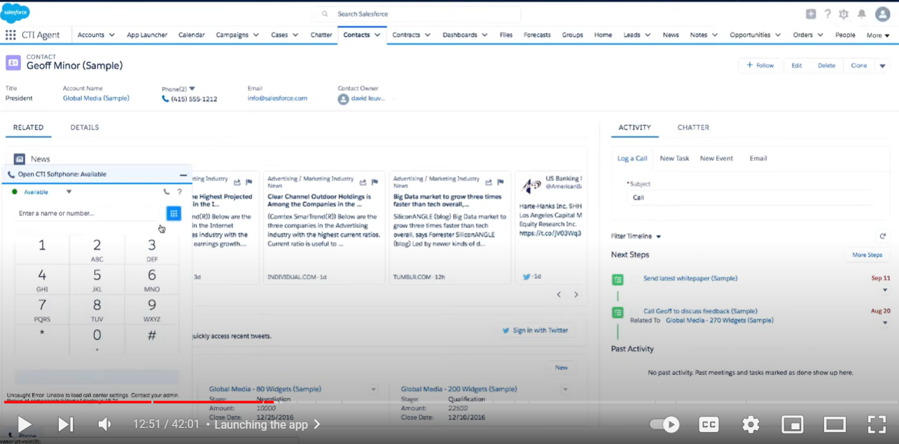

Slide 11
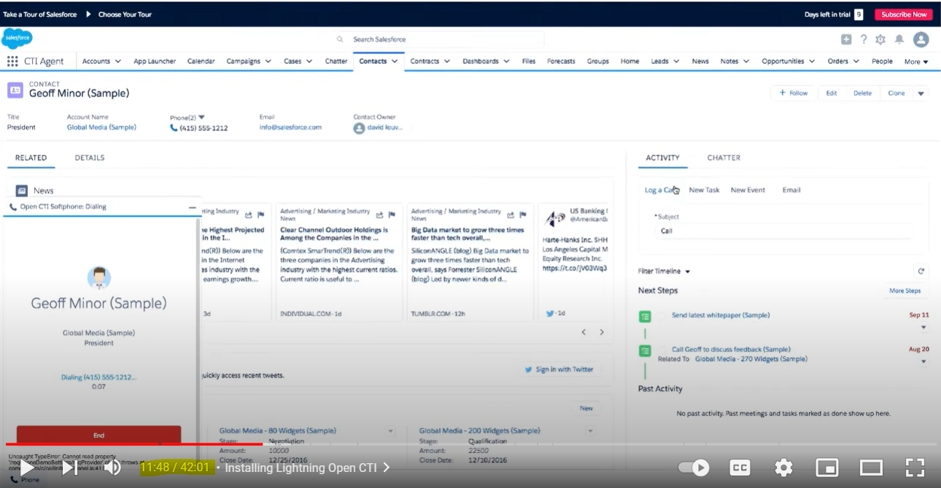

Slide 12
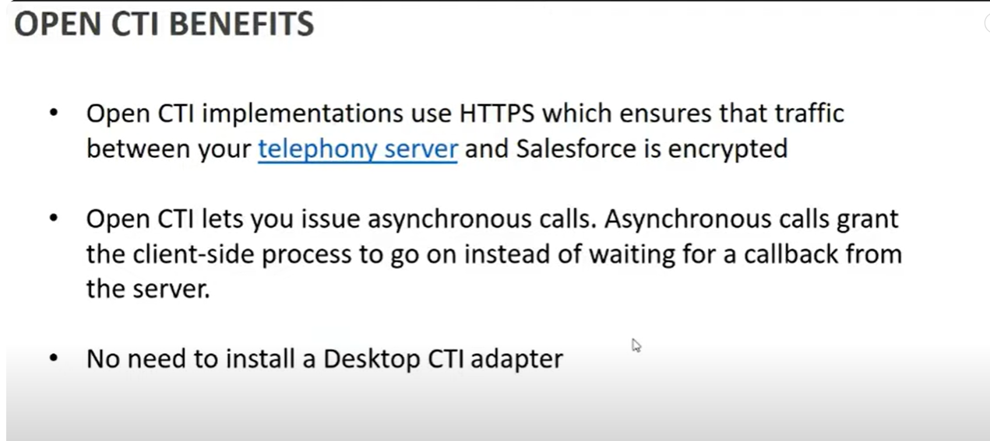
Dynamic delivery
Learn to infuse energy into your delivery to leave a lasting impression
One of the goals of effective communication is to motivate your audience
Metric | Measurement | Target | Actual
Audience attendance | # of attendees | 150 | 120
Engagement duration | Minutes | 60 | 75
Q&A interaction | # of questions | 10 | 15
Positive feedback | Percentage (%) | 90 | 95
Rate of information retention | Percentage (%) | 80 | 85

Slide 13
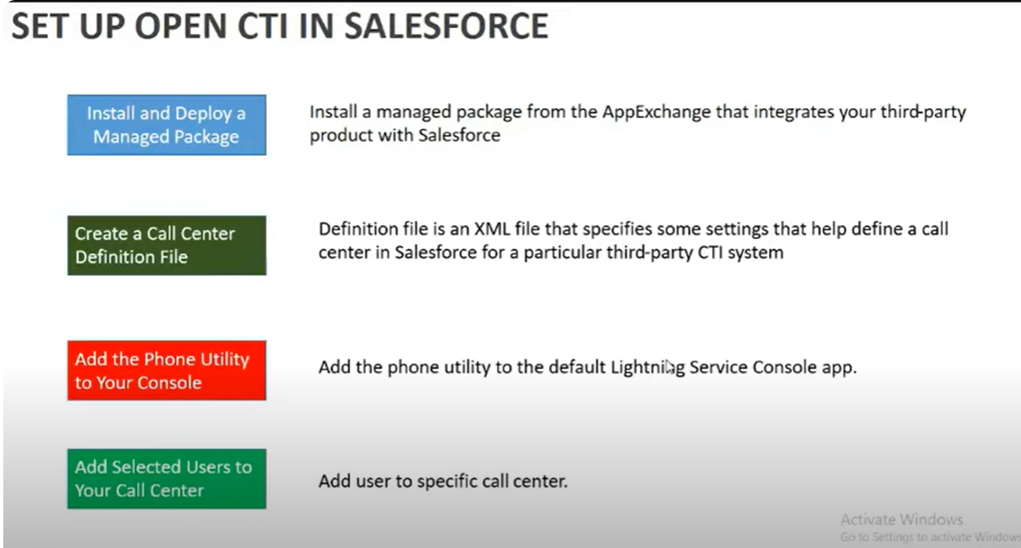

Slide 14

Thank you

